Slide 1
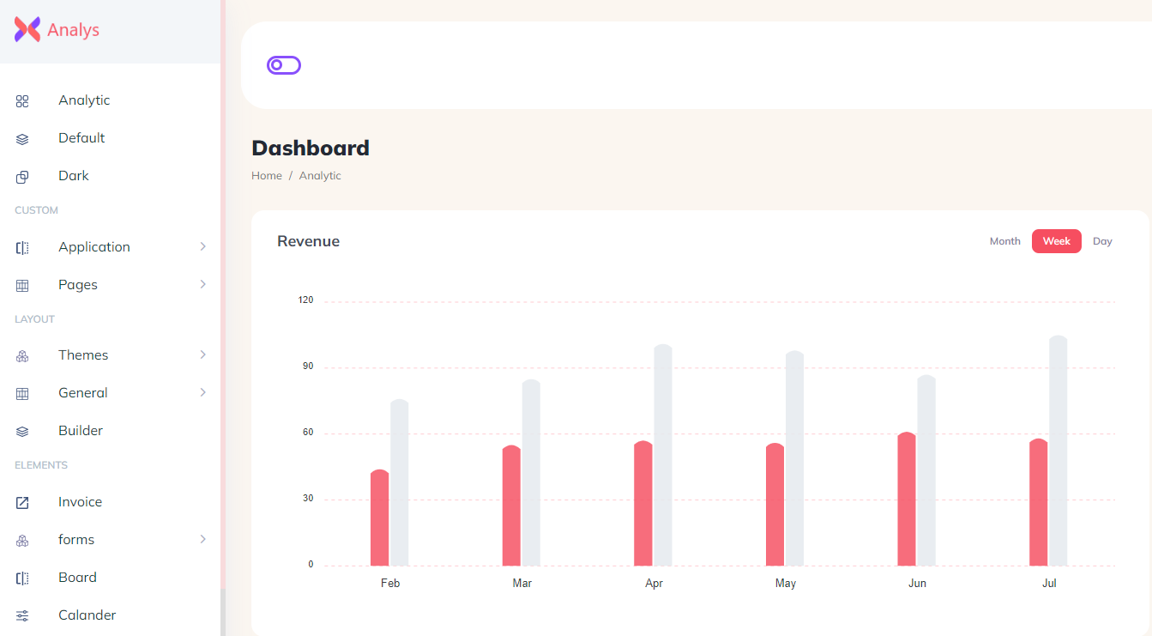

System to get data from database
Database
php
java
Html, css, js
nodejs
python
.net

Slide 2




































Slide 3








































Slide 4
Users
Name
Email
MobileNo
Address
Username
Password
Role
IsActive
Bookings
Username
PackageId
NoOfAdults
NoOfChilds
ArrivalDate
ReturnDate
WithTransport
TransportId
Packages
HotelId
Duration
AdultPerPersonCost
ChildPerPersonCost
Facilities
Discount
Type
TourReviews
Username
BookingId
Rating
Comment
Hotels
Name
Description
Country
City
Street
Zip
Transports
Type(Air, Bus, Train)
VendorName
IsAcSeat
TicketPrice
StartingLocation
DestinationLocation
BoardingPoint
DroppingPoint
HotelRooms
PackageId
Size
Type
RoomView
ExtraFacilities
Beds
Images
IsAvailable
UsersQueries
Name
Email
Phone
Country
Subject
Message
TourLocations
Name
Country
City
Images

Slide 5

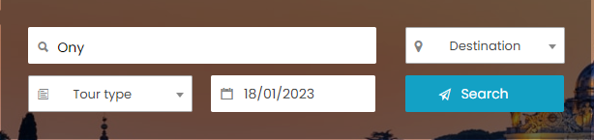
Home
About Us
Services
Contact

